Slide 1
Adaptive Methane Detection
Author: Kern Ding
Mentor: David Thompson, Lance Christensen

Slide 2
Outline
Simulate Methane Distribution
Update Hypothesis Probability
Expected Information Gain to start path planning
Demo on real data
Project Overview

Slide 3
Project Object
JPL has developed a hand-held methane sniffer that can be deployed on a flying robot.
To develop an automated system that guides the robot or person carrying the sniffer from first detection to the leak source.
Input: methane concentration and wind vector at detected location
Output: direction to the leak source

Slide 4
Foundation Approach
The approach is a Bayesian Model
First, set several hypotheses(leak location, leak concentration)
Using the collocated data to update the probability of those hypotheses

Slide 5
Outline
Simulate Methane Distribution
Update Hypothesis Probability
Expected Information Gain to start path planning
Demo on real data
Project Overview

Slide 6
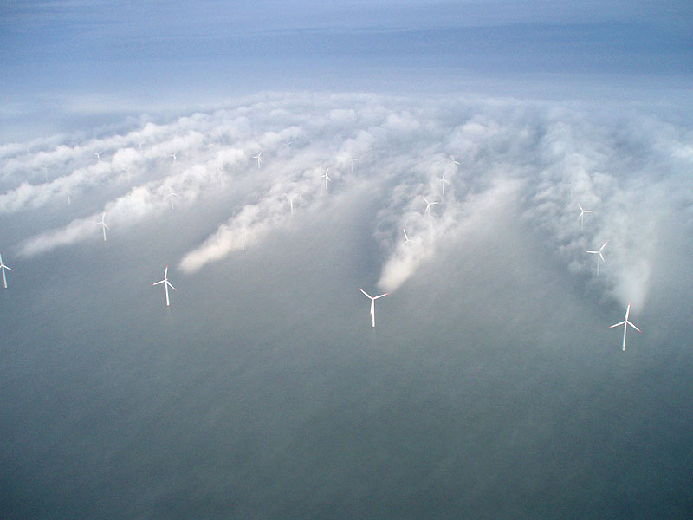
Simulate wind turbulence
Gaussian Distribution
Notes:
Simulate both methane movement with wind and methane diffusion

Slide 7
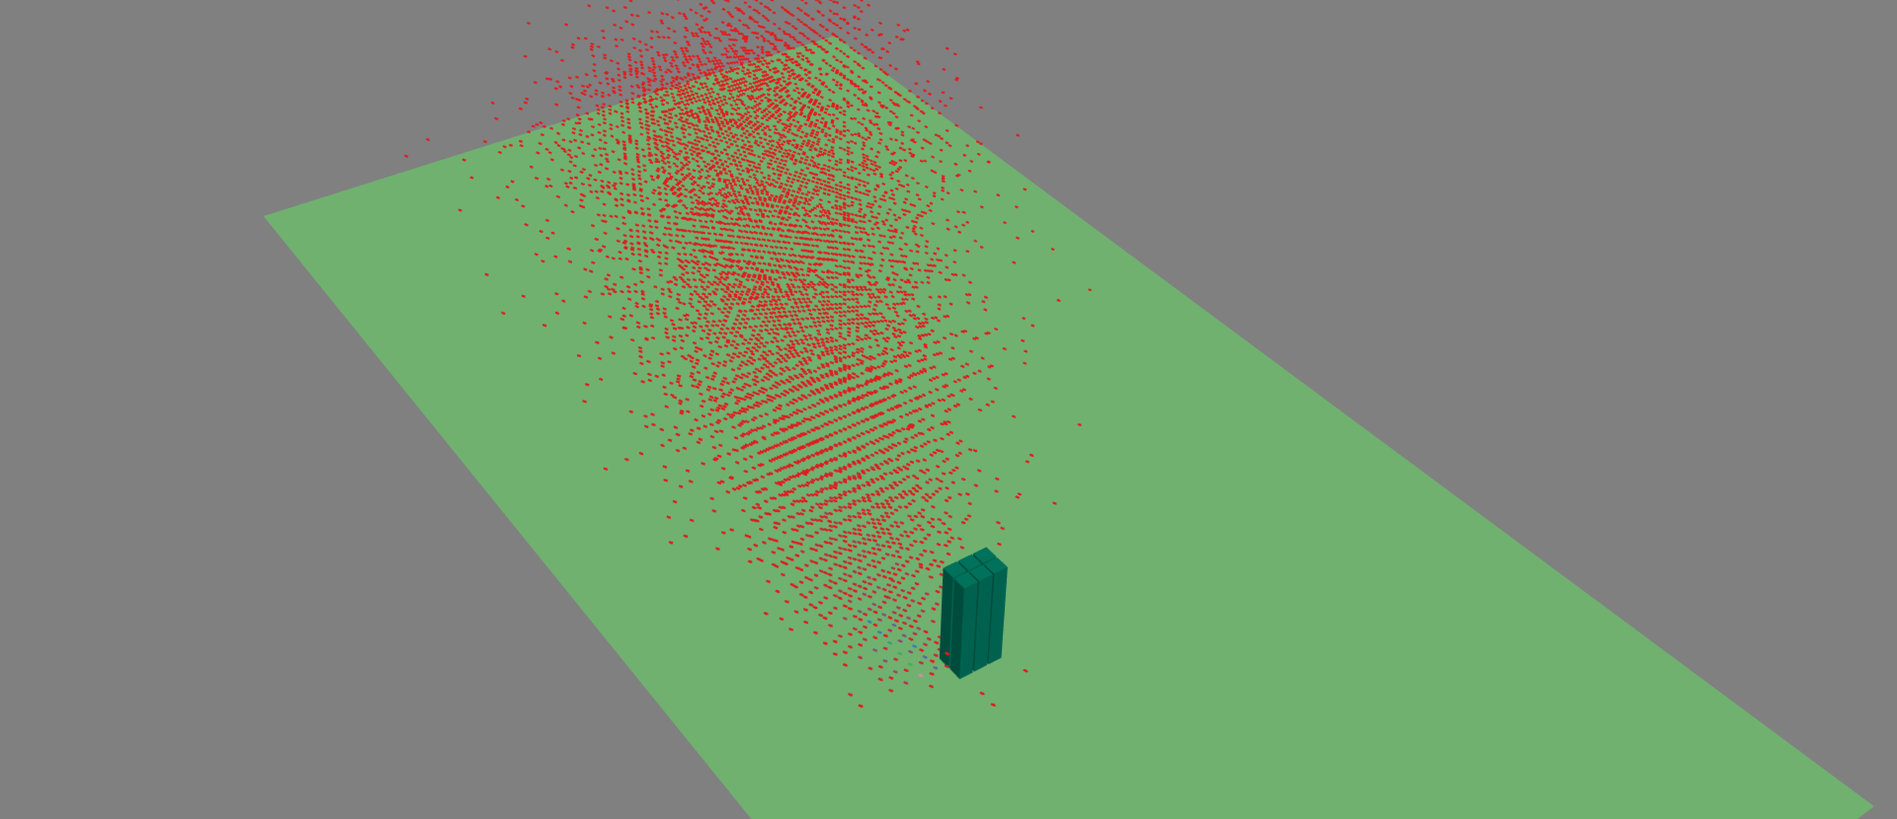
Wind turbulence using Gaussian Distribution

Slide 8
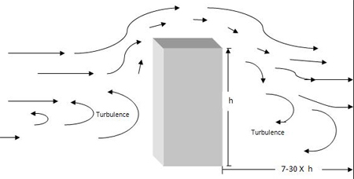
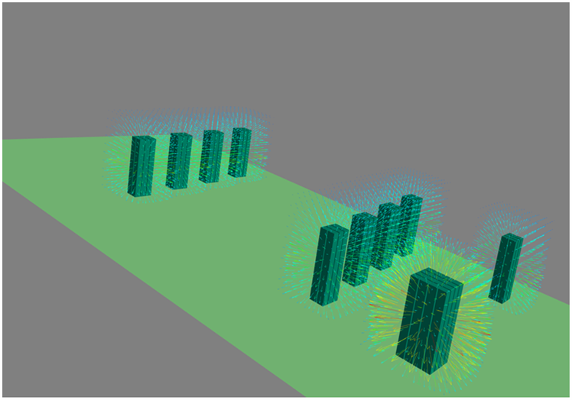
Local potential field by obstacle
Calculation Wind Vector =
Real wind + Local potential

Slide 9
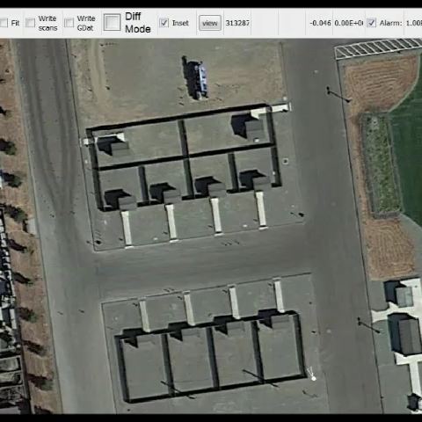

Build the map model

Slide 10
Build a virtual world for hypothesis
Decompose the map into cells tagged as building, air and ground.
Make a methane leak location cell and its leak concentration as a hypothesis.
Distribute methane from cells to cells using Gaussian distribution by calculated wind.

Slide 11
Outline
Simulate Methane Distribution
Update Hypothesis Probability
Expected Information Gain to start path planning
Demo on real data
Project Overview

Slide 12
Calculated methane concentration under each hypothesis
Concentration plot in 4 Different hypotheses virtual worlds
We normalized the probability for all the hypotheses in the initialized stage:
$${probability}^{i}=1/N$$
For the virtual world according to each hypothesis, calculate the methane concentration in every cell in the map.
We can draw the concentration/coordinate plot as left showing
We normalized the probability for all the hypotheses in the initialized stage:
〖𝑝𝑟𝑜𝑏𝑎𝑏𝑖𝑙𝑖𝑡𝑦〗^𝑖=1/𝑁
For the virtual world according to each hypothesis, calculate the methane concentration in every cell in the map.
We can draw the concentration/coordinate plot as left showing

Slide 13
Model the likelihood using gamma distribution

Slide 14
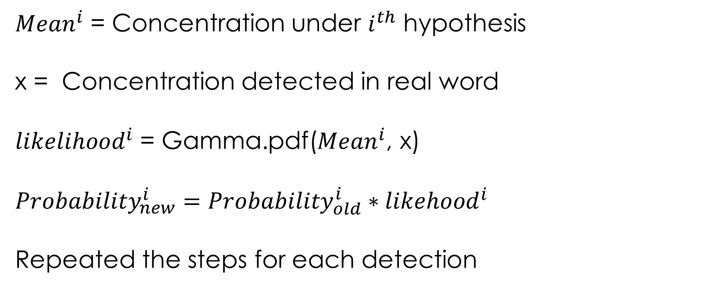
Model the likelihood using gamma distribution
${Mean}^{i}$ = Concentration under $i^{th}$ hypothesis
x = Concentration detected in real word
${likelihood}^{i}$ = Gamma.pdf(${Mean}^{i}$, x)
$${Probability}_{new}^{i}={Probability}_{old}^{i}∗{likehood}^{i}$$
Repeated the steps for each detection

Slide 15
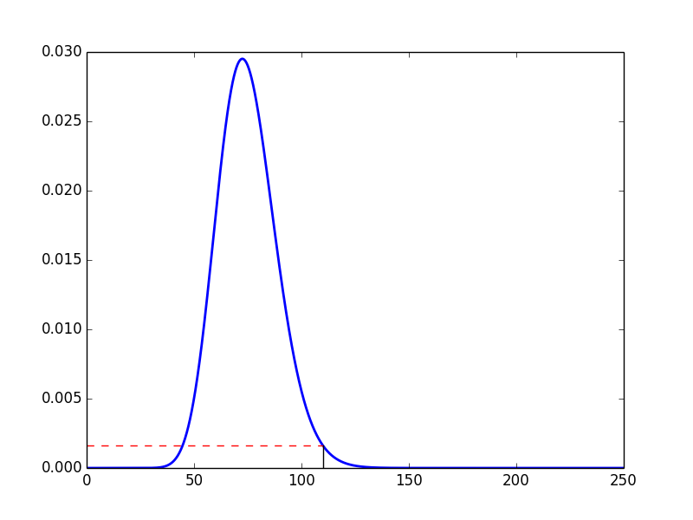
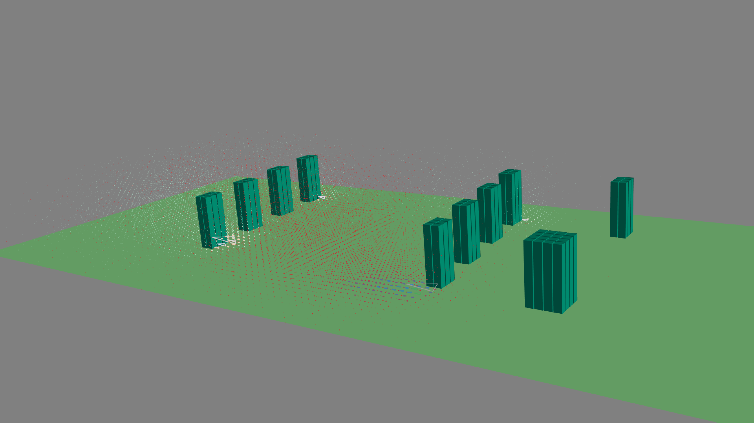
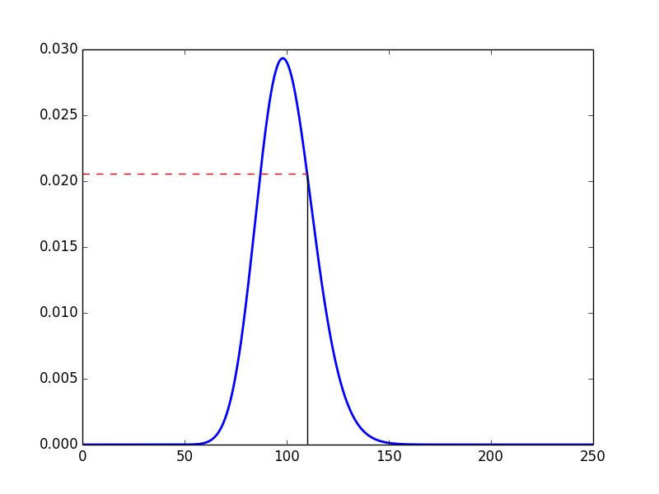
Model the likelihood using gamma distribution
Hyp#2
Hyp#1

Slide 16
Outline
Simulate Methane Distribution
Update Hypothesis Probability
Expected Information Gain to start path planning
Demo on real data
Project Overview

Slide 17
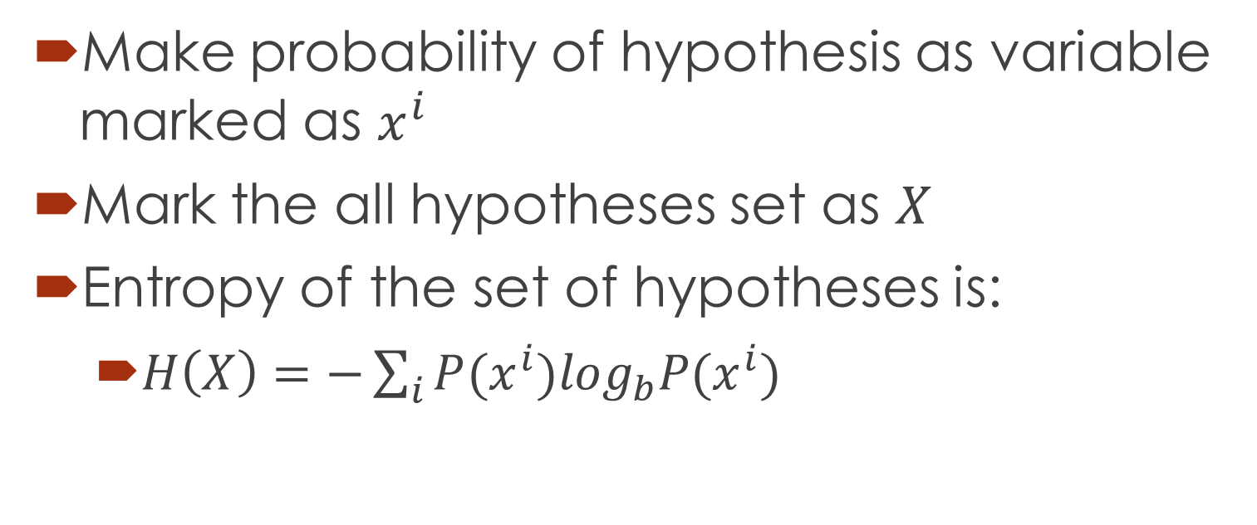
Entropy for the set of hypotheses
Make probability of hypothesis as variable marked as $x^{i}$
Mark the all hypotheses set as $X$
Entropy of the set of hypotheses is:
$H\left(X\right)=−\sum_{i}{P(x^{i})\log_{b}P(x^{i})}$

Slide 18
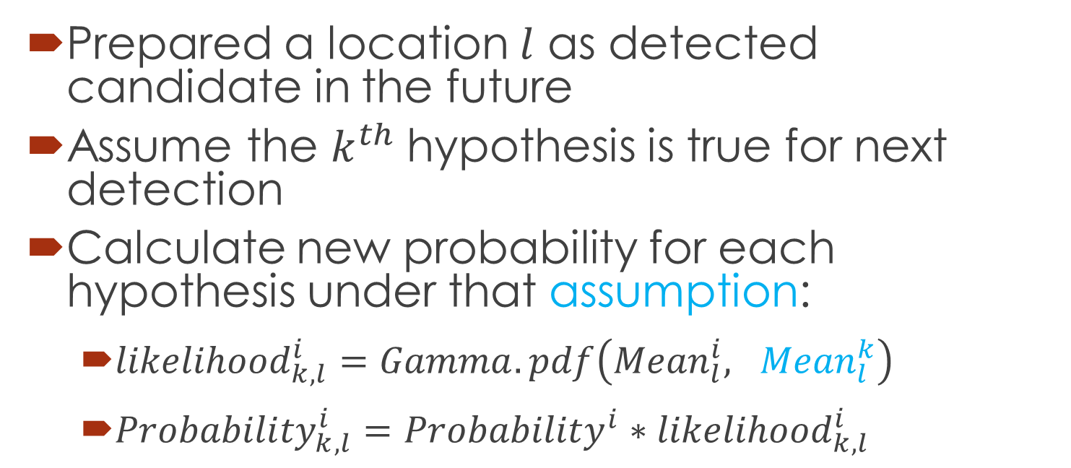
Update probability in the future under specific assumption
Prepared a location $l$ as detected candidate in the future
Assume the $k^{th}$ hypothesis is true for next detection
Calculate new probability for each hypothesis under that assumption:
${likelihood}_{k,l}^{i}=Gamma.pdf\left({Mean}_{l}^{i}, {Mean}_{l}^{k}\right)$
${Probability}_{k,l}^{i}={Probability}^{i}{∗likelihood}_{k,l}^{i}$

Slide 19
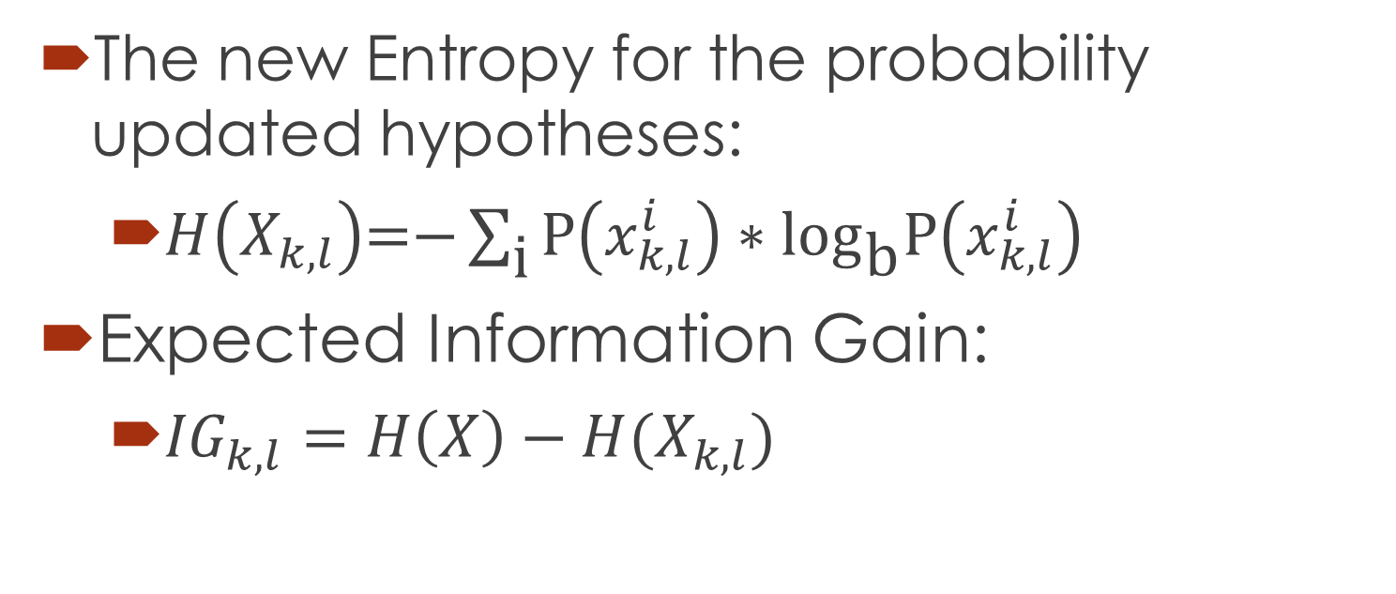
Expected Information Gain under specific assumption
The new Entropy for the probability updated hypotheses:
$H\left(X_{k,l}\right)\text{=−}\sum_{\text{i}}{\text{P}\left(x_{k,l}^{i}\right)∗{\text{log}}_{\text{b}}\text{P}\left(x_{k,l}^{i}\right)}$
Expected Information Gain:
${IG}_{k,l}=H\left(X\right)−H(X_{k,l})$

Slide 20
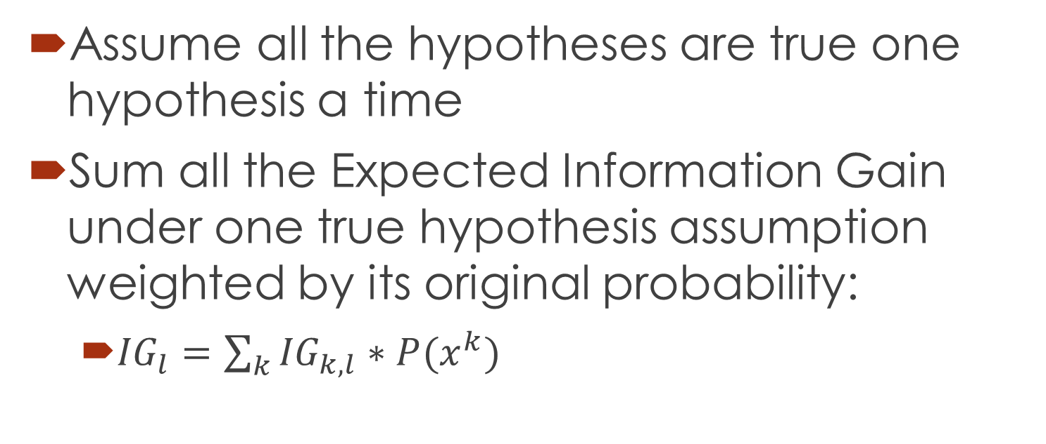
Sum the Expected Information Gain for each assumption
Assume all the hypotheses are true one hypothesis a time
Sum all the Expected Information Gain under one true hypothesis assumption weighted by its original probability:
${IG}_{l}=\sum_{k}{{IG}_{k,l}∗P(x^{k})}$

Slide 21
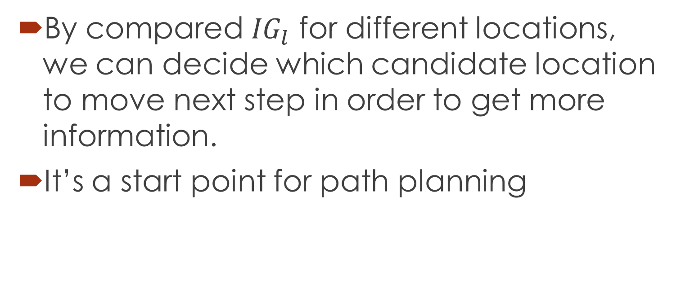
Choose candidates by Expected Information Gain
By compared ${IG}_{l}$ for different locations, we can decide which candidate location to move next step in order to get more information.
It’s a start point for path planning

Slide 22
Outline
Simulate Methane Distribution
Update Hypothesis Probability
Expected Information Gain to start path planning
Demo on real data
Project Overview

Slide 23
A virtualization Demo
Thank David for all his the intelligent ideas and algorithm framework
Thank Lance for his real world knowledge and practical experience to build our model
Here is a Demo running on real data collected by Lance.

